Slide 1
Avalanche Transistor Nanosecond Pulse Generator
February 21, 2023
Liam Keeley
https://github.com/3-3-3

Slide 2
Topics
Avalanche transistor theory
Circuit Design
Results
Next steps

Slide 3
Avalanche Transistor Theory

Slide 4
Bipolar Junction Transistor Review
A semiconductor is a material where the valance band and conduction band are close to each other (< 1 eV), but do not overlap
Pentavalent impurities–e.g. phosphorous–introduce some electrons just below the conduction band (n-type doping)
Trivalent impurities–e.g. boron–introduce holes which are near the valence band and can trap electrons (p-type doping)
An npn Bipolar Junction Transistor consists of a a small slice op p-type silicon–the base–between to slices of n-type silicon (the collector and emitter)
*See Chapter 13 and 14 of [1] and Chapter 4 of [2]

Slide 5
Transistors In Avalanche Breakdown Mode
Imagine slowly increasing collector-emitter voltage with the base grounded:
At low voltages, conduction electrons have low kinetic energy and eventually fall into holes through collisions with molecules in the base
At high voltages, conduction electrons are accelerated to high energies between collisions. If–on the mean free path between collisions–they reach energies higher than the semiconductor band gap, they can excite additional electrons to the conduction band
Result: chain reaction in which many charge carriers are generated and a high current pulse is generated

Slide 6
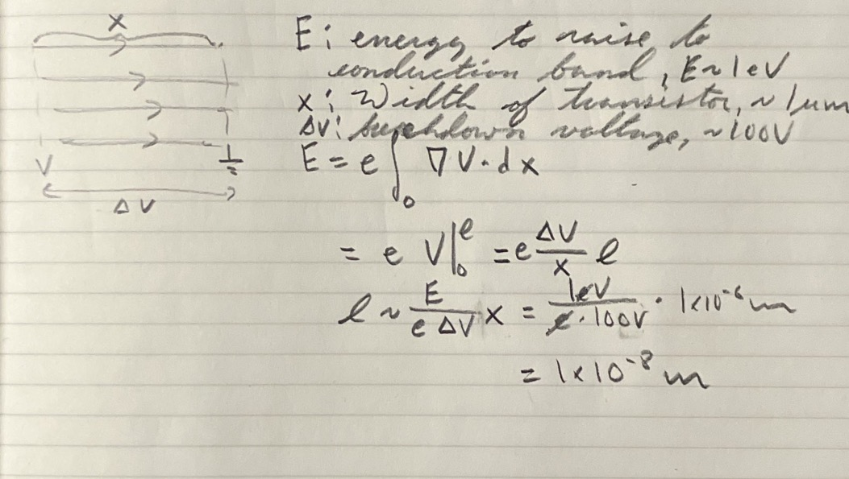

Slide 7
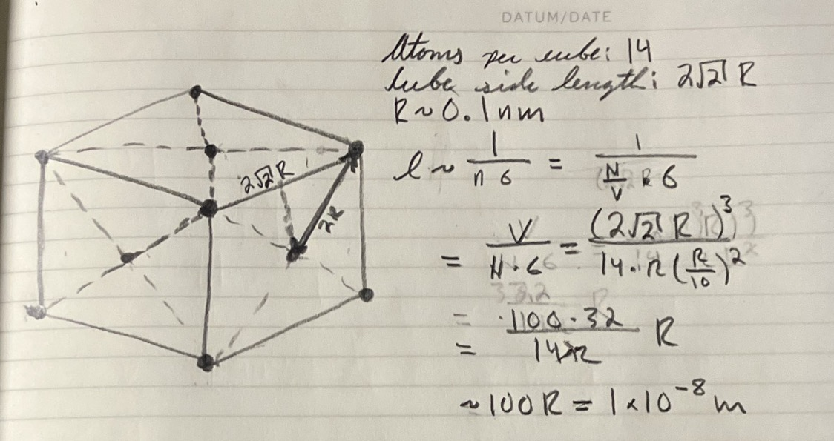

Slide 8
Trigger
Hold potential just below breakdown, then:
Hold emitter at a small negative potential
Hold base at a small positive potential

Slide 9
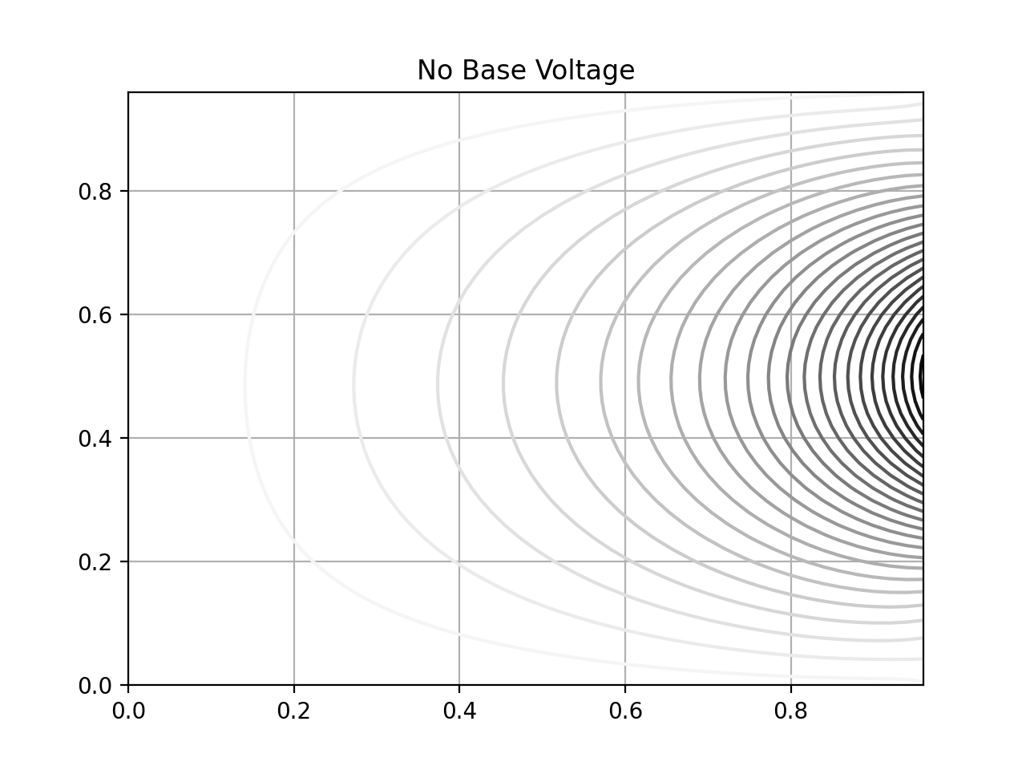
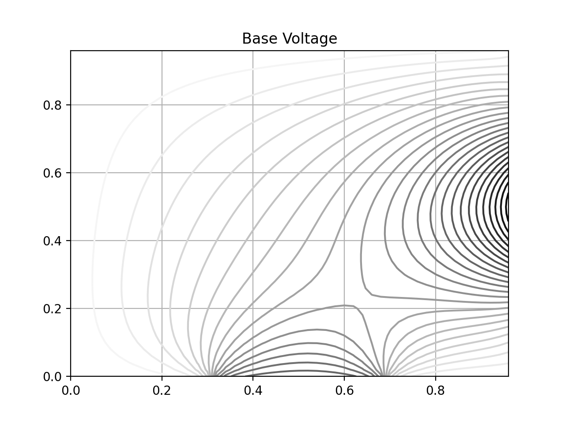
Finite Difference of Laplace’s Equation
*Gaussian boundary condition at collector
**See Chapter 4 of [3]

Slide 10
Circuit Design

Slide 11
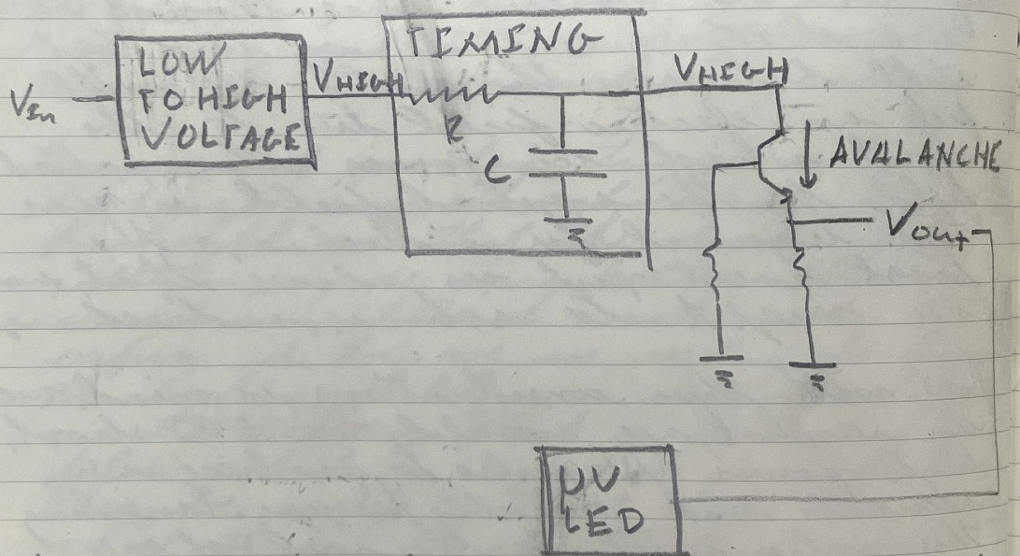
Initial Circuit Idea

Slide 12
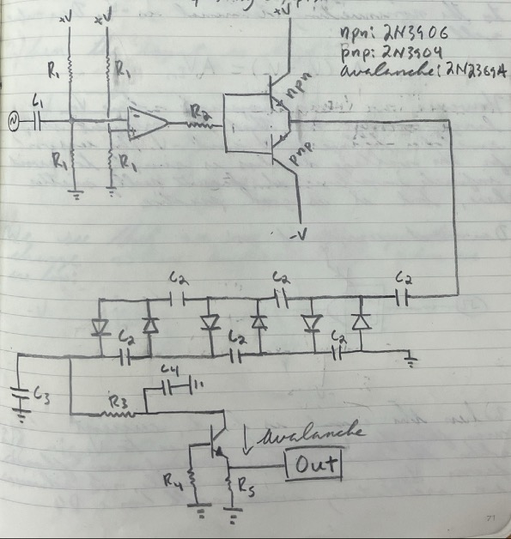
First Working Circuit

Slide 13
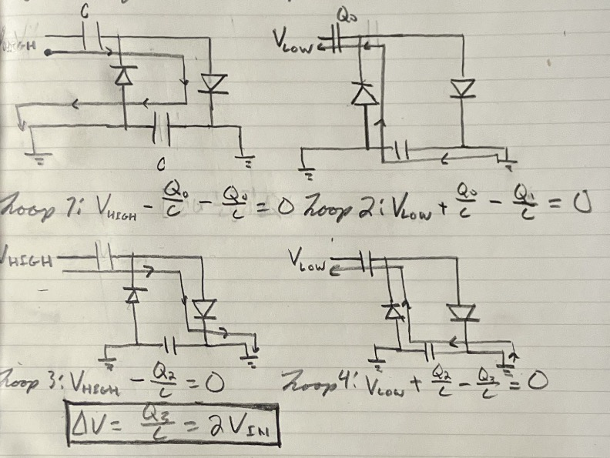
Voltage Multiplier

Slide 14
Results: No Trigger

Slide 15
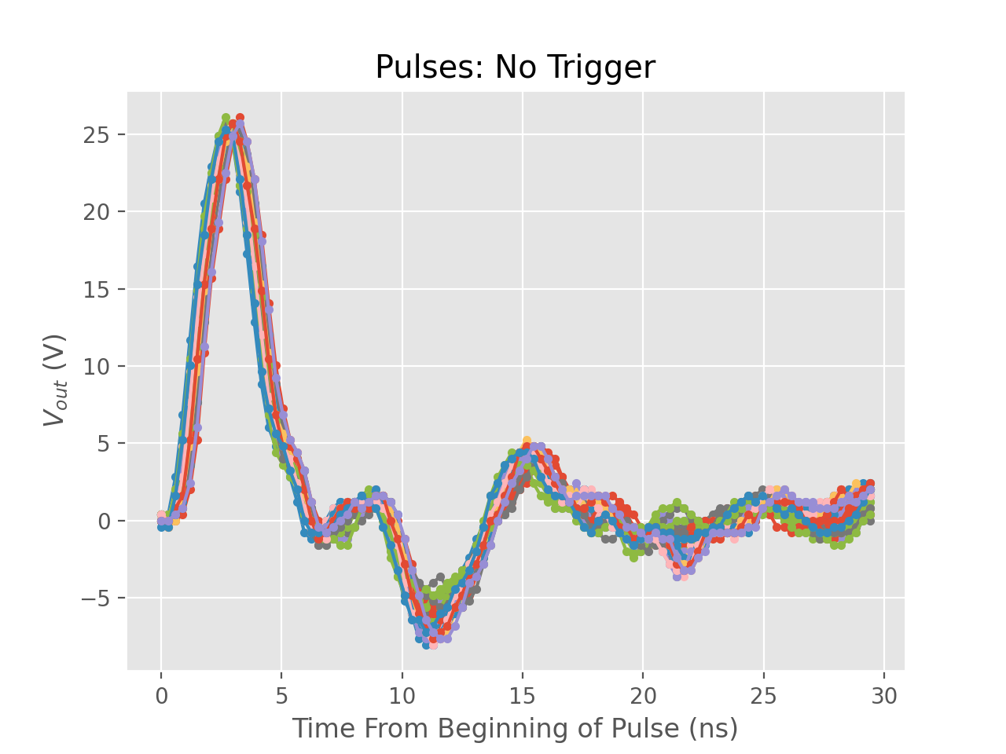

Slide 16
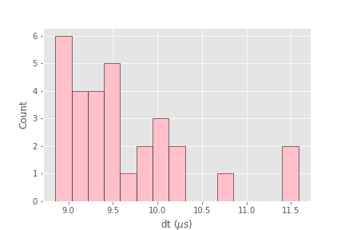

Slide 17
Results: Trigger

Slide 18
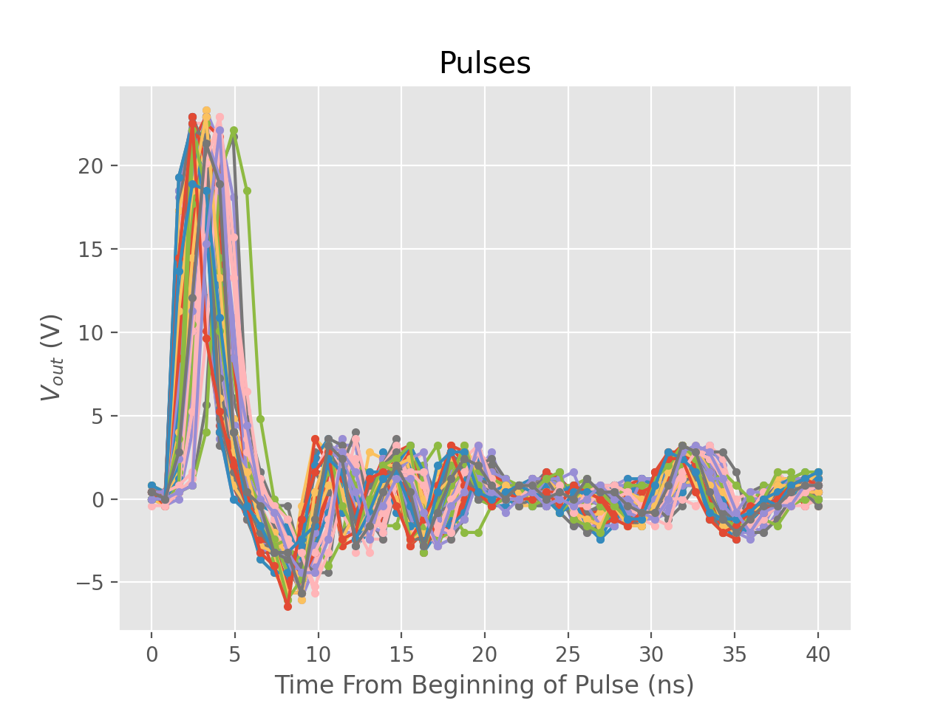

Slide 19
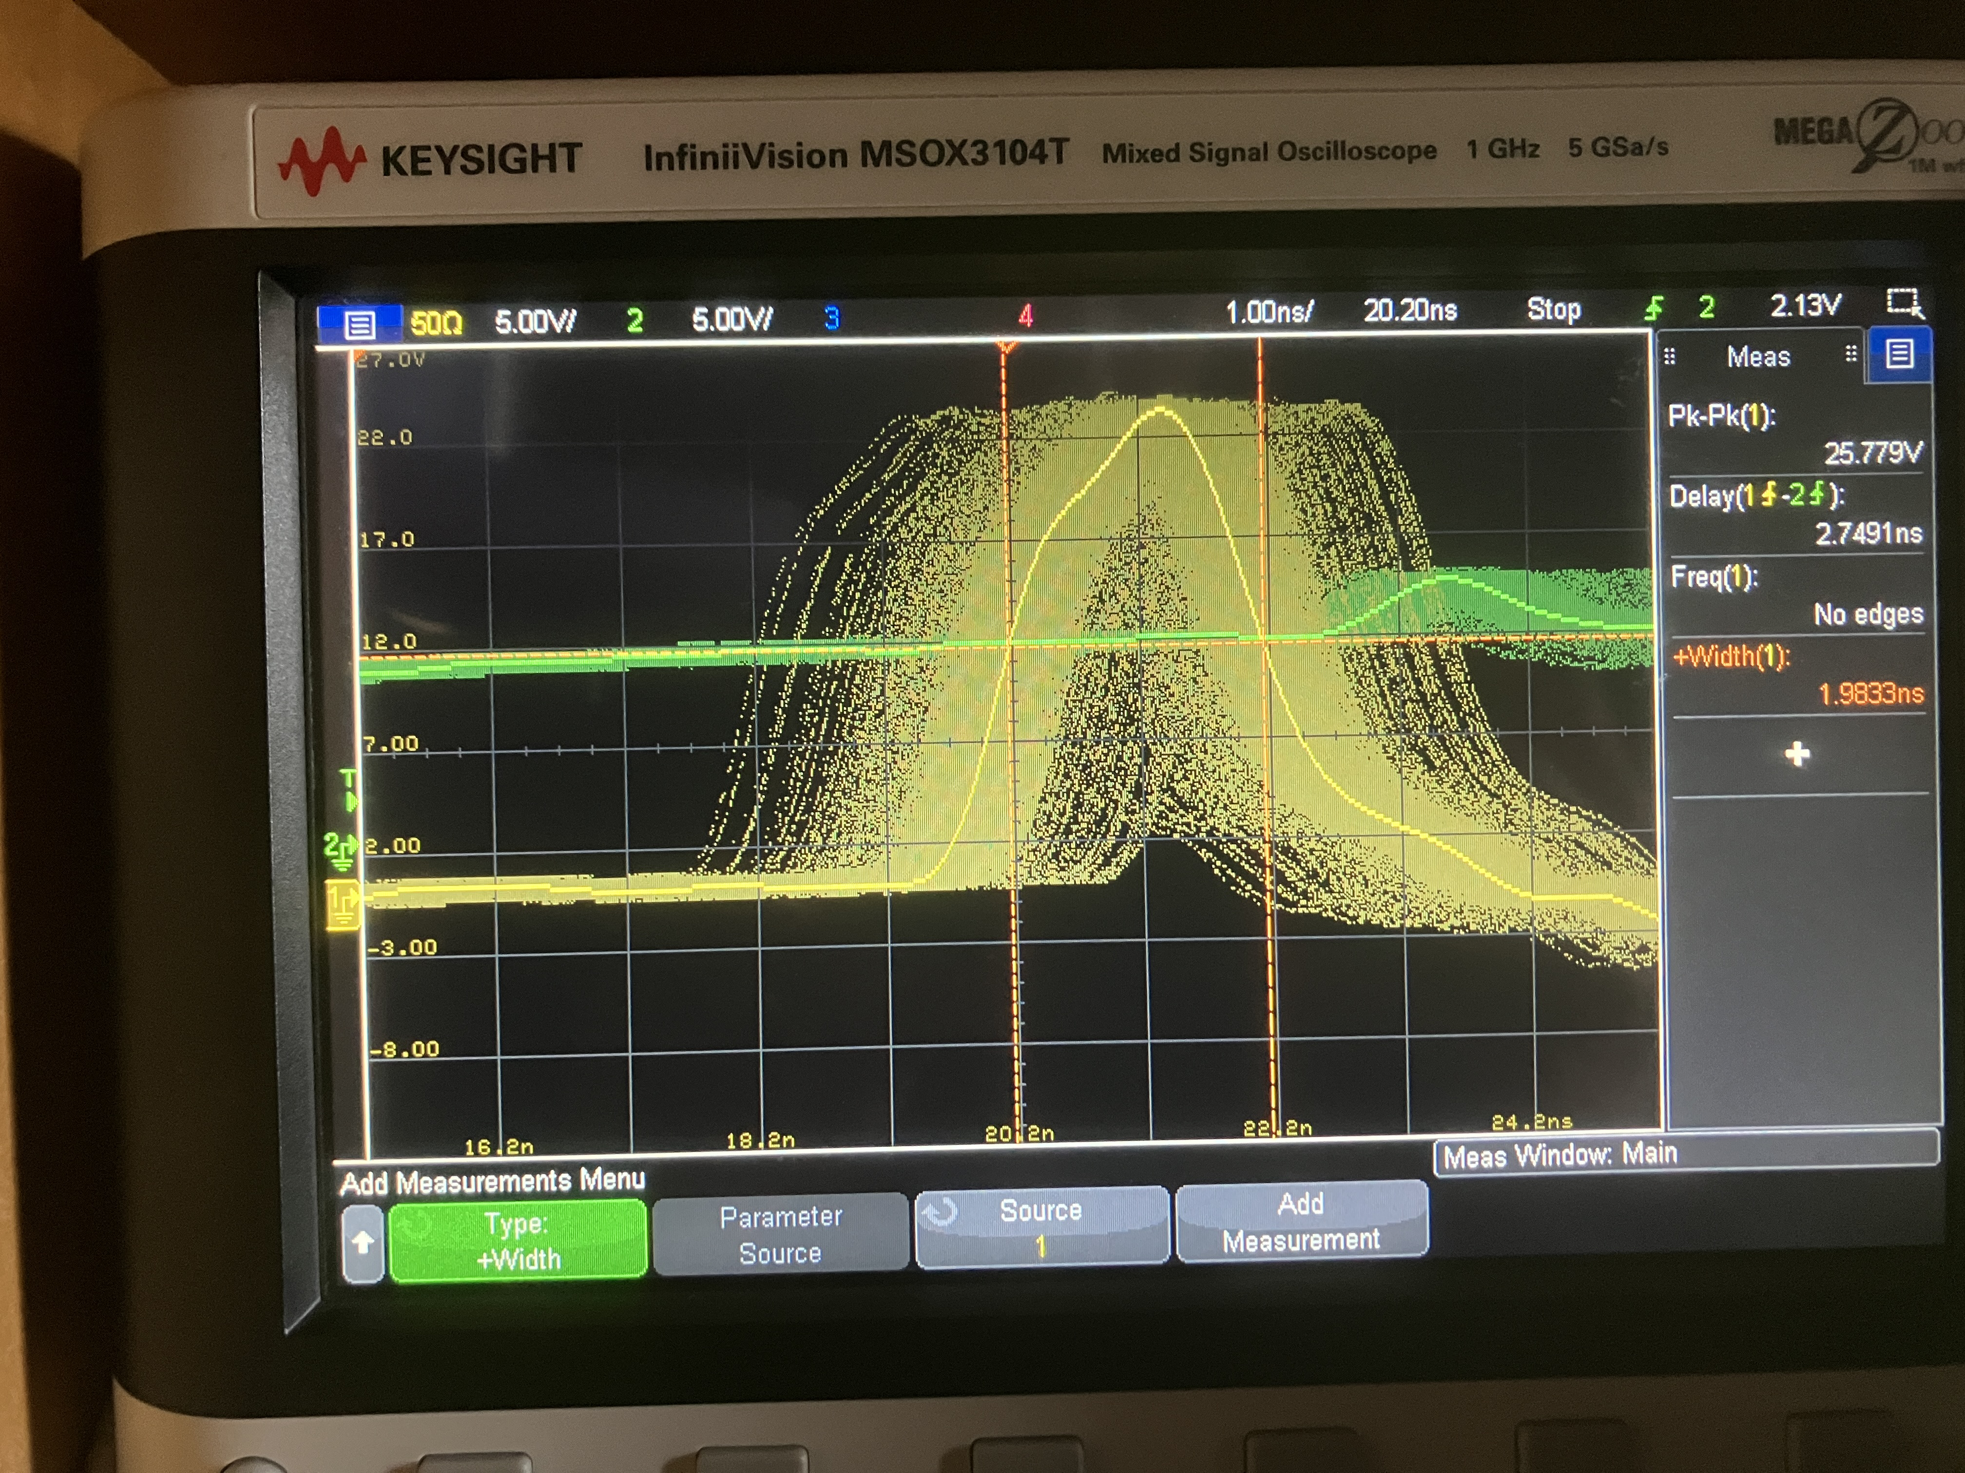
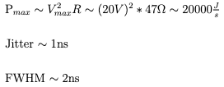
*Oscilloscope trace of pulses driven at 40 kHz with 1s persistence.

Slide 20
Next Steps

Slide 21
Use to pulse UV-LED in spark gap experiment
Adjust as need. Likely, we will need more power, as the current pulse is low energy. There are a number of ways to chain transistors together to avalanche all at once and pull more current from the charged capacitor
Replace charging function generator with oscillatory circuit

Slide 22
Works Cited
[0] Jeff Steele
[1] John Taylor, Chris Zafiratos, and Michael Dubson. Modern Physics For Scientists and Engineers, 2nd ed, University Science Books 2015.
[2] Paul Sherz and Simon Monk. Practical Electronics For Inventors, 4th ed, McGraw-Hill 2016.
[3] Franklin, Joel. Computational Methods for Physics, Cambridge University Press 2013.
[4] Williams, Jim. Application Note 72, Linear Technology 1998. pp. 33-34.
[5] http://dangerousprototypes.com/blog/2013/07/20/avalanche-pulse-generator-and-some-scope-porn/

